Slide 1


IT343: Operating System
July – November 2020
Chapter – 9
I/O Management
Devang Patel Institute of Advance Technology and Research

Slide 2

How Does The Disk Look Like?

Slide 3
Platters
Hard disks are organized as a concentric stack of disks. An individual disk is referred to as a platter.
Each platter consists of two surfaces: a lower and an upper surface.
The platters within the hard disk are connected by a spindle that runs through the middle of the platters.
The spindle moves in a unidirectional manner along its axis (either clockwise or counterclockwise).
The movement of the spindle causes the platters to rotate as well.

Slide 4
Read/write head
Each surface on a platter contains a read/write head that is used to read or write data onto the disk.
The read/write heads can move back and forth along the surface of a platter. Read/write heads are in turn connected to a single actuator arm.
Tracks
Each surface of a platter consists of a fixed number of tracks. These are circular areas on the surface of a platter that decrease in circumference as we move towards the center of the platter.
Data is first written to the outermost track.

Slide 5
Sectors
Each track is divided into a fixed number of sectors. Sectors divide track sections and store data.
Computer Science: A Structured Programming Approach Using C

Slide 6
Example- Calculate disk size
Suppose we have 480 cylinders. It is divided into 120- cylinder zones with the cylinders in different zones containing 200, 240, 280, and 320 sectors. Assume each sector contains 4096 bytes. What is the disk capacity?

Slide 7
Solution
To get the capacity of the disk, multiply the total number of sectors by the sector size.
The total number of sectors is 120*200 + 120*240 + 120*280 + 120*320 or 124800
so the total disk capacity should be 124800 * 4096, or 511,180,800 bytes.

Slide 8
Disk Scheduling
The operating system is responsible for using hardware efficiently — for the disk drives, this means having a fast access time and disk bandwidth.
Access time has two major components
  Seek time is the time for the disk are to move the heads to the cylinder containing the desired sector.
  Rotational latency is the additional time waiting for the disk to rotate the desired sector to the disk head.
Minimize seek time
Seek time ≈ seek distance
Disk bandwidth is the total number of bytes transferred, divided by the total time between the first request for service and the completion of the last transfer.

Slide 9
Disk Scheduling (Cont.)
Several algorithms exist to schedule the servicing of disk I/O requests.
We illustrate them with a request queue (0-199).
98, 183, 37, 122, 14, 124, 65, 67
Head pointer 53

Slide 10
How to find total head movement
98-53= 45
183-98=85
183-37=146
122-37=85
122-14=110
124-65=59
67-65=2
Total head movement= 640 Cylinders

Slide 11

FCFS
Illustration shows total head movement of 640 cylinders.

Slide 12
FCFS
Advantages of FCFS:
Easy to understand
No starvation (may suffer from Convey Effect)
Can be used with less load
Disadvantages of FCFS:
Require more seek time
More waiting time
Inefficient

Slide 13
SSTF
Selects the request with the minimum seek time from the current head position.
SSTF scheduling is a form of SJF scheduling; may cause starvation of some requests.
Illustration shows total head movement of 236 cylinders.

Slide 14

SSTF (Cont.)

Slide 15
SSTF
Advantages:
Very efficient in a seek time
Less average Response time and seek time
Increased Throughput
Disadvantages:
Overhead to find out closest request.
If less load then easy implementation but more load then starvation occurs.

Slide 16
SCAN
The disk arm starts at one end of the disk, and moves toward the other end, servicing requests until it gets to the other end of the disk, where the head movement is reversed and servicing continues.
Sometimes called the elevator algorithm.
Illustration shows total head movement of 208 cylinders.

Slide 17
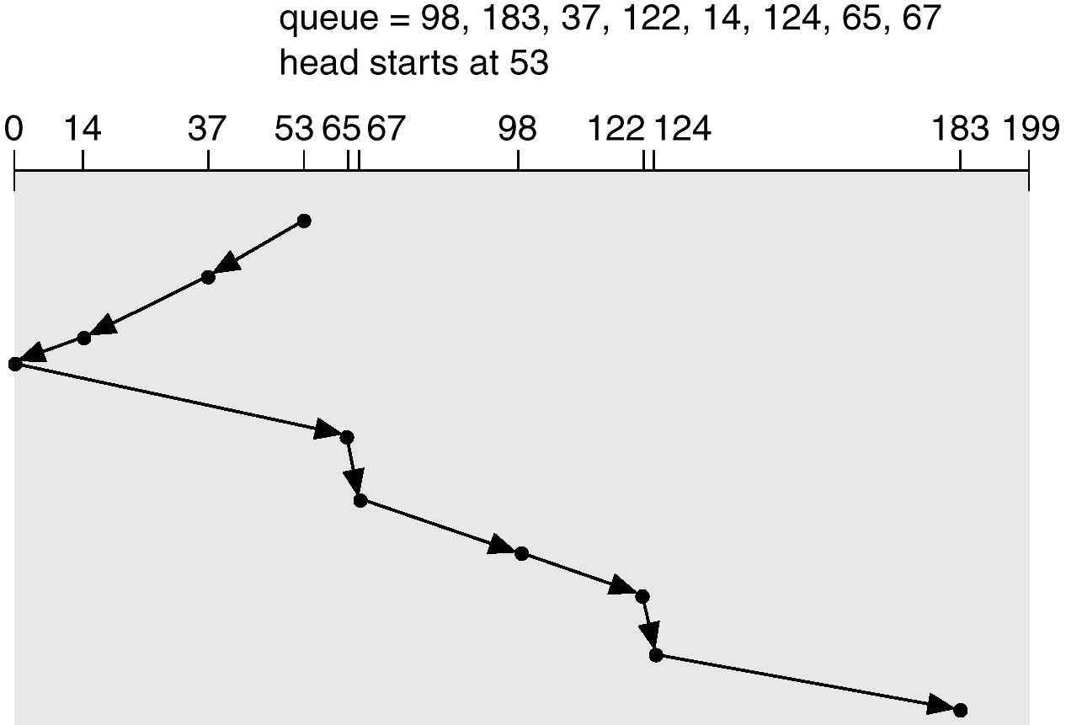
SCAN (Cont.)

Slide 18
SCAN
Advantages:
Simple Easy to understand and implement
No starvation (bounded waiting)
Low variance and average waiting time.
Disadvantages:
Long waiting time for that area which is just visited by head.
Unnecessary move till the end of the disk.

Slide 19
C-SCAN
Provides a more uniform wait time than SCAN.
The head moves from one end of the disk to the other. servicing requests as it goes. When it reaches the other end, however, it immediately returns to the beginning of the disk, without servicing any requests on the return trip.
Treats the cylinders as a circular list that wraps around from the last cylinder to the first one.

Slide 20

C-SCAN (Cont.)

Slide 21
C-SCAN
Advantages:
Provide uniform waiting time
Better response time
Disadvantages: more moments compared to the simple scan

Slide 22
C-LOOK
Version of C-SCAN
Arm only goes as far as the last request in each direction, then reverses direction immediately, without first going all the way to the end of the disk.

Slide 23

C-LOOK (Cont.)

Slide 24
C-LOOK
Advantages:
More uniform waiting time compared to look
Less head move compare to c-scan
Disadvantages:
More overhead in calculation
Should not used in more load

Slide 25
Selecting a Disk-Scheduling Algorithm
SSTF is common and has a natural appeal
SCAN and C-SCAN perform better for systems that place a heavy load on the disk.
Either SSTF or LOOK is a reasonable choice for the default algorithm.

Slide 26
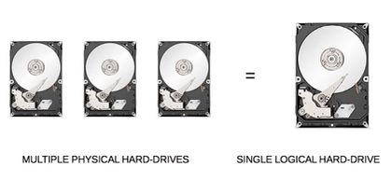
RAID- Redundant Array of Independent Disks

Slide 27
RAID- Redundant Array of Independent Disks
RAID – multiple disk drives provides reliability via redundancy.
RAID is arranged into different levels.
Several improvements in disk-use techniques involve the use of multiple disks working cooperatively.
Disk striping uses a group of disks as one storage unit.
RAID schemes improve performance and improve the reliability of the storage system by storing redundant data.

Slide 28

RAID Levels

Slide 29
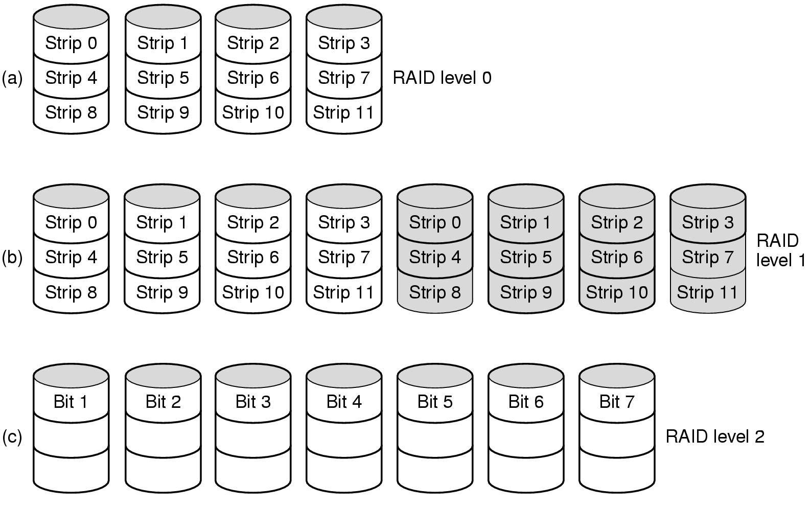
Raid Levels(continued)
RAID 0 : Stripping. It offers the best performance, Does not provide redundancy or fault tolerance
Also known as disk mirroring, this configuration consists of at least two drives that duplicate the storage of data. There is no striping. Read performance is improved since either disk can be read at the same time. Write performance is the same as for single disk storage.
RAID 2 use bit level stripping. Instead of striping the blocks across the disks, it stripes the bits across the disks. You need two groups of disks. One group of disks are used to write the data, another group is used to write the error correction codes. This uses Hamming error correction code (ECC), and stores this information in the redundancy disks. This uses lot of disks and can be configured in different disk configuration. This is not used anymore. This is expensive and implementing it in a RAID controller is complex, and ECC is redundant now-a-days, as the hard disk themselves can do this.

Slide 30
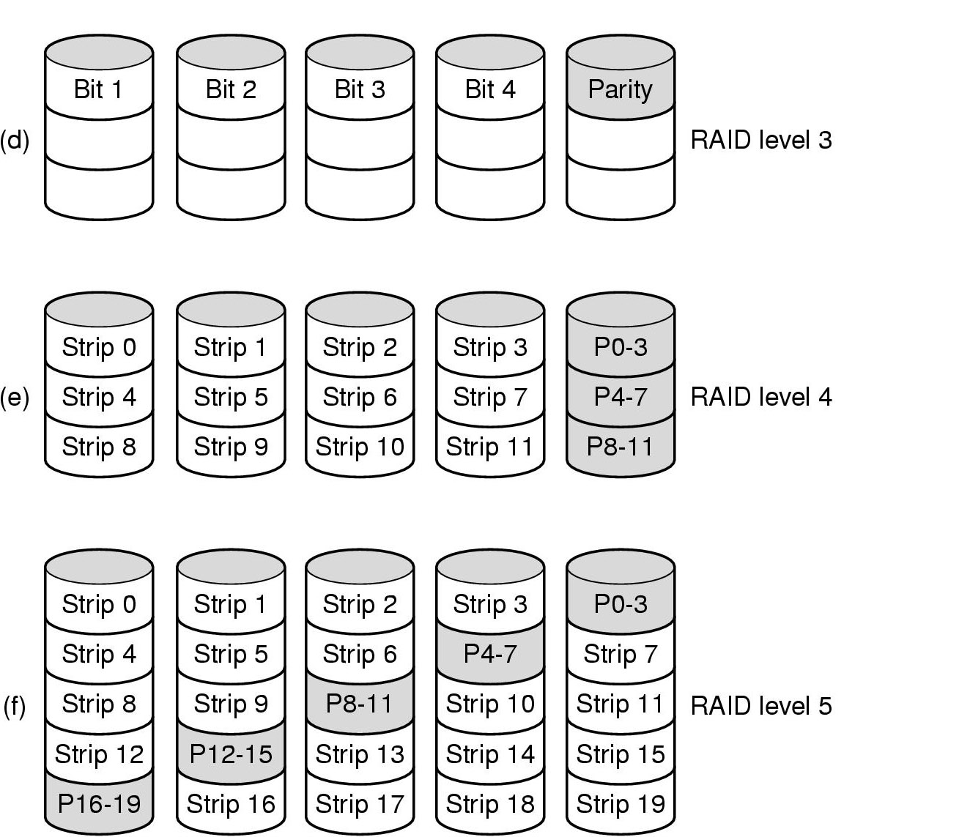
Raid Levels (continued)
This uses byte level striping. Uses multiple data disks, and a dedicated disk to store parity. Sequential read and write will have good performance.
Random read and write will have worst performance.
This is not commonly used.
This level uses large stripes, which means a user can read records from any single drive. Overlapped I/O can then be used for read operations. Since all write operations are required to update the parity drive, no I/O overlapping is possible.
This level is based on parity block-level striping. The parity information is striped across each drive, enabling the array to function even if one drive were to fail. The array's architecture allows read and write operations to span multiple drives resulting in performance better than that of a single drive, but not as high as that of a RAID 0 array. RAID 5 requires at least three disks, but it is often recommended to use at least five disks for performance reasons.

Slide 31
Raid Levels 6 and 10
RAID 6:P and Q redundancy
RAID 10: heterogeneous disks array

Slide 32
Summary
We looked various disk scheduling methods to optimize secondary storage access.
We also studies basic principles of RAID.

Slide 33
Thank You

